Slide 1


Riverltl.
HttddJ -
0p fil j
Presents
Music by Aaron Copland
Libretto by Horace Everett
Friday, June14, 20197:30PM. Sunday, June16,20193:00PM. Orr Auditorium
John Wood Community College

Slide 2
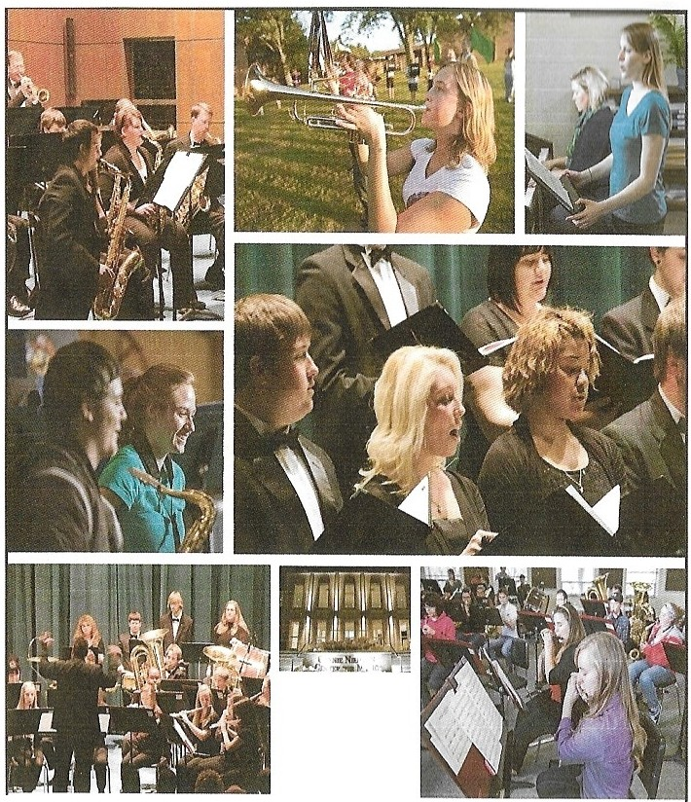
Muddy River Opera Company Presents
The Tenderland
AnOpera inThreeActs Musicbq
Aaron Copldnd
Librettobq
HordceEverett
Bq arranaement withBooseq & Hawkes, Inc,publisherand copqriaht owner.
JoinDr.Carol Mathieson for q,era fnsi@dsintoThe Tender Land'simpact on societq and musical culture 30 minutesbeforeeachperformance.
Svnopsis:
The isolated world of a rural family turns around the graduation of its
elder daughter. Yet, she is unsure of her place in that world. It is invaded by a threat and then an actuality of two outsiders who excite in the girl dreams of a larg e r life. The boys are accepted into the community as harvesters.
At a party on the eve before graduation, one of them falls in love with the girl.
The match is discovered by the grand,pa and the boys are ordered away.
The boy and the g irl plan an e lo pement at daybreak, but the boy, attacked by fears of responsib ilily abetted by forebodings of his companion, flees. The girl 's antic ipation of fulfil ment turns to despair when she finds the boys gone. She is consoled by her family who remin d her of graduation and the pattern of her life. But she realizes that the time has come to break that pattern and assert her own being. Though accepting, the mother does not recognize the woman her daughter has become. And as the girl goes to find her own life, the mother turns to her younger daughter k1mwing that one responsibility has ended and another has begun.
1
't
This proe,ram wa.s ma.de possible b.J a.a.5 ra.11t from the Arthur 0 .and Lela.B. Lindsay Fund throue,h the Community Foundation.
The next stepinyour musical journeyis righthereinQuinc.y Q
QuincyUn ivres ityoffersdegrees in:
Music
Music Education
Communication/Music Production
Church Music
Be apart of QU's exclelentperforming groups.
Marching Band • SymphonicBand • Jazz Ensemble
GuitarEnsemleb• Chamber Choir • Concert Choir Regarldessof your musical interest,make the most of your talentand career optionsby joiningthe Music Program atQuincy University today.
Make More Great Music Here in Quincy!
u I NCY
This proe,ra.m was made possible by a.a.e,ra.nt from the DennisR.and Barbara.L.Willia.ms Fund £or
Arts and Education throue,h the
L
u N J V E Rs I Ty
C C
t
Muddy
earn. are. onne, c
1800 CollegeAvenue
Quincy, IL 62301
217-228-5210
www.quincy.edu
Community Foundation.
Riverli1ml
Opera•■■i1m
eompany

Slide 3
TheCharacters
LamieMoss,an18lJear old 5irl.............................................................P.. enelope Shumate, soprano
Ma Moss............................................._................................................................l..i.sa Blake, contralto
Beth Moss, Laurie's101.Jear old sister...........................................:..E.....millJ Dozier, soprano
Grandpa Moss, the fmnill.J patriarch..................................................Mark Gil5allon, bass Martin, a drifter......................................................................................S...t.ephen Carroll, tenor
Top, a drifter...........................................................................................S..tevenSoebbin5,baritone
Mr.Splinters, the Postman............................................................ atthew Scheuermann, tenor
Mrs.Splinters, his wife...................................................................................A.. my Stollber5, mezzo- sop ra no
Mr. Je nks, a ne i5hb or..................................................................................David Czechut,ba ritone
Mrs.Je nks,his wife...................................................................G.. retchen Wolfme 1:1e r, mezzo- sop ra no
Chorus
Rebekci.h Adams, Anna Gabel,Richard li esslin5, Larl'lj McNett , PaulShelor and Maurice Silas.
Muddy RiverOperaCompany
Fou11ded in 1989btJ Mani AnneScott tJ..nd MflrlJ Jm1eMcCloskelJ, QuinctJ's MuddlJ Rtver Opera Compo.nlJ Wfl.S incorporated in Illinoisas a non-profit ar tsor5anizalion in1990. Scott and McClosketJ ha d twoseminal5otJ.ls in mind:to produce professionfll operolle
performtJ.nces m1d to makeeductJ.tio nal operatic opportunitiesavailable to the tri-slt d.o aretJ..!11 keepin5with the mission of its founders, the Company consistentll) produce s lwo lo four operasetJ.ch 1Jem.MROC productionsof forei511-lan5ua5eoperasare usual!lJ performed in En5lish translation. Iiowever, in recent lJea rs,the Compa111J has mounted the occasional production in ori5infll lan5ua13e with projected:En13lish supertitles.
MROChiresseveral5uest artists as professional si115 e rs, directors, desi5ners and/orinstrume11tal musicians for everlJ production. Althou5h the Board of Directors
acceptsprofessional credentials thro1.15hou t the lJear ,open auditionsfor roles in all productions tak e place prior lo the be13h111i n5 of each newseason.Thus, the CompanlJ
assures exper ie11ce but alsoutilizes th e re5ional communihJ's ow n impressive reserveof line sin5ers,musicians, and artists and alsooffersopportunities for lJ01.tnl3er musicians to13row into the operaticperfonna nce tradition.
MROChas produced both traditionaland twentie th- centur lJ operasand operettas includin/3: Die Zauherflote, La boheme,Dialoguesof {beCarmelites, The Pirates of Penzance, The Merr y Widow; Jonah, TlieMedium,La fraviata,Die fledermaus,Abe, The Mikado, Cosl fa11tutte,Gic1111i Schiccl1i,Suor A11gelicc1, flhar.biere di Sivi'glia,Ri<5ol e tto,
HMS Pinafore, A Little Nigllf Music,Carmen and L'Efisir cl'Amore.
Partof the CompcU11/s mission is to educa te local 5rad e school students about opem throu5h MROC Educational Outreacl lours. O verseen bl) an MROCdirector,castsfrom the opera workshops of Culver-StocktonColle5e, John WoodComnmnittJ Coll e13e, and Quincy UniversihJ tour in QuinClJ, Adams,Pike Counlies and Missouri withchildre,i's operas of
hi13h-quality musichut appropriat e storlJ l eve l. Pas t productions include: The MiniMagic
flute, Alicein Opera Lm1d,NoyesB udde,li owNm1iftl Letm 1eclto Mc1k e fl tm, lim1sela11d Gr e te l, and Jack anclthe Bem1sftllk as well as Clum licleera nd Little Reel Riding Hood
MROCcelebrated its 20thseason with a Mat) ,2010 production of Puccini's Mc1clc1111a Butterfly,feat urin l3Quincy nativeand inle rna tiona lllJ known sopranoMichele Crider as Cio-CioSan. In the 2016production of P uccini's Suor/21{Jelica,reeional musicians honored the memoni of Avril MarieBermen's lile and commitment to operadurin5 her
20-ljear tenureas Artistic Director.However, the 2017 prodnclionof Bizet's Carmen
celebrated newbe5innin5s co111inl3fullcircleas the Co111pa ny revitali7.ed the ori5inal vision of its founders to brin/3to5ether professional a rtistsworkiri/3 in the performance world , excellent re5ional musicians, and dedicated students to join fo rces .tooHer th e entire community the very finest in operaticexperience.
Sce11e: The action takesplaceona lower-middle-classfa.rm in th e mid- west. The time
isin the earllJ thir ti es -
] une-the time of sprin5araduation and sprin5 harvest.
Act I Act II Act III
The dalJ before 5radua lion- la te afte rn oon. That evenin5.
Later that niaht;then ₅ ra.dua tion da1J-dawn.
Background
The son of Russian Jewish immi5ra nts,Aaron Copland' s musiccame to represent what wasquintessentiallJl A merica n in art music of th e 1930'sand '40's. In his 1920's composition studies in Paris, his renowned mentor Nadia Boulan5er admonished him to
write what he knew...to b e an Am eric a n . lie obeyed and produced balletsand film music that incorporated Appalachian folk music and cowbolJ da nce music intoa sound pa lette that wasstill quite avant-aarde.Expandin5 hisresponsibilities to A merica n music as an expression of American character,he represented the U.S.State Department as a
cultura l ambassador duri115 and after WWII. While visitin5 Latin America, he echoed his mentor's advice and e11coura5ed local composers tohonor their owncommon people as the keepersof a national aesthetic.
Ballets, film scores,and instrumental music underscore ideas and moments rather than text. Plot isexpressed throu₈h a esture or structural loaic. Copla nd wanted to write an opera,but he wanted American opera to be more harmonically complex than the musicalcomedies that were sopopularat that time. It is, th erefore , ironicthat he composed T.b.e Tender LcindcourteslJ ol a commission sponsored by Rodaersand
Ii amme rste in, the most estab lished creators0£ mus ical co medy oi th eir dalJ.
Althou5h the operafulfilled Copland's aoals, it confuse d his a ud ie nce . It was written for
television, but stationswouldn't air it because it didn't have a head-on conflict or simple, melodious set nu mbers as Menotti's Amc1.b.lcwd theNight Visitorshad had.
Librettist:E.rik Johns,writina as Horace Everett,said that I.be Tender Lcindwas "an opera.tic tone poem," a hJ rical look at the ideal ot followin5 dreamsof one'sown111ak in5 .
And after all,what isthat but the AmericanDream?
11uldt
1
Ri,Ter!t l
Opera ·-•·
company

Slide 4
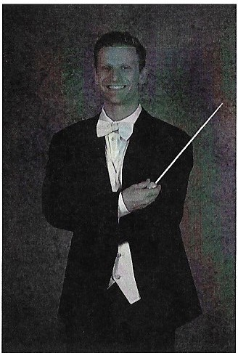
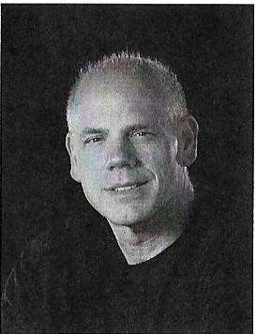
MIIIJdy
Dr.DavidGa.lant-Conductor
Dr. David Michael Galant has recently accepted the Assistant Professor 0£ Music position at Creiahton University and will
be Music Director of th e Creiahton Symphony O rchestra.in their 2019- 2020sea.son. lie also is the Director of the Ka.nesville Symphony in Council BluHs,Iowa and the TrinitlJ United Methodist Chancel Choir of Ra lsto n, Nebraska. This past year Dr.Gala.nt was Assistant Conductor with Winter Opera.
St.Louis in their productions of Die Fledermaus, conducted the
Charleston S1:JmphonlJ in South Carolina. under the mentorship of Ma.rk Gibson, a.nd conducted Chess the musical with TheTADA Theatre in Lincoln, Nebraska..
Produ tion Sta££
n.1v1irlenl
, 11Hll'ai!ll51w
(}lllljlilllY
MuddtJ River Artistic Directors
Carol Mathieson, Steven Soebbin5, Amy Stollber5
Director...................................................................................................P. aulSho111os
Conductor...........................................................................................Da.vid Galant li all and A/V Ma.na5er.........................................................Garris Brown
Sta5e Mana.5er.....................................................................Ra nd tJ W olfmetJer
Chorus Master.............................................................................Paul Shelor
Concert Mistress......................................................................J..a..n. e Polett
Orchestra.Liaison...................................................................................V. icki Da55 e tt
Rehearsal Pianist.....................................................................................Lana Anderso11
Choreo5rapher..........................................................................................D. re w Quintero
Set Desi5n..............................................................................................J..i.ll liibba.rd
Tech a.nd Liahtin5..................................................................................Cha.ndler FetJ
Costume Desi5ner.................................................................................V. a.lerie Ii erna.nd e z
Crew..................................................................................Adrienne Fisk and Samantha. Pillars
Set Construction...........................................David Brown.CodtJ P ezold,Alex Crai5
TheJenderL&n d_Or hestra
Flu te
Kristen An₈uia.no
1st Violins JanePolett
Willia.mShomos-Director
William Shomos is Director of
O pe ra. at U NL,which earlier this tJe a.r toured a. production of
Tlie Te11der Ldnd torural Nebraska.. Since be5innin5 his professional directin5career with Muddy River Opera some 25 yea.rs a.50, he has direct ed for numerous companies. lii5hli5hts of his si115i115 career include the role of W oHra m in
W a5ner's l c1.nnh tiuser in Tirana, Albania- - the la.nd of his he rit a.5e , and a Lincoln appea rance a.s Don Quixote in Man of Ld Mdnc.b.d.
Eddie Binosi
Mad al1:J11Pridemore
Clarinet
Alan Nichols
2nd Violins Vicki Da5aett Patricia Kuhn Ava.Miller
Bassoon
Jane Iiolt
liarp
Melanie Allen
Viola
Davidlierma1111 Ka.e Blecha.
Percussion Ma.cMcPike Bill Winn
Cello
Kosuke Uchikawa Me5a11Bocca rdi
Piano
Lana. A nderson
Bass
Fra.nk Nor th

Slide 5
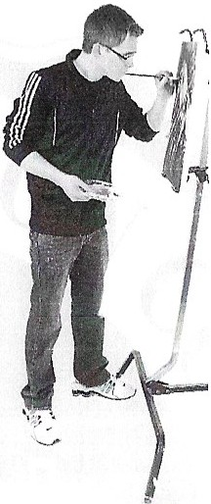
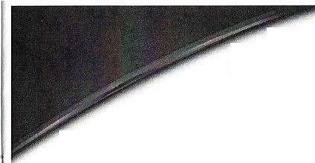
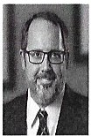
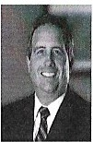
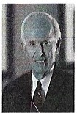
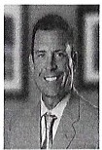
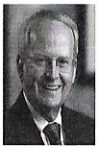
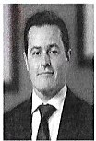
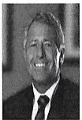
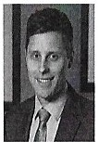
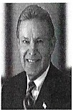
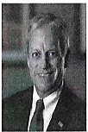
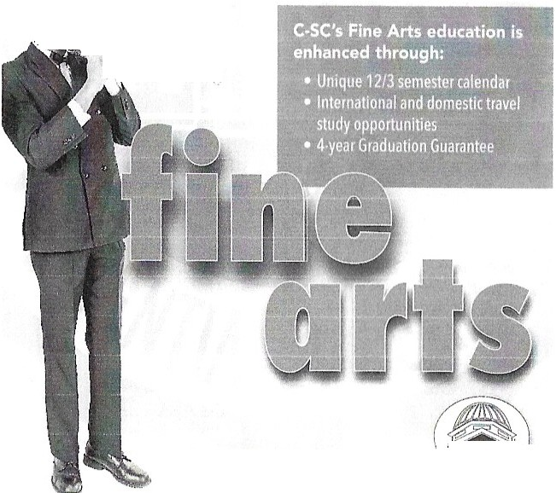
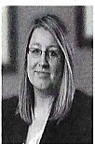
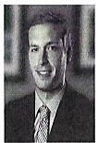
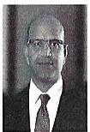
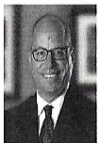
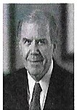
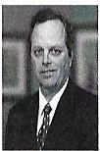
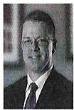
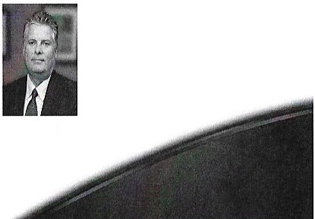
CULVER-STOCKTON COLLEGE
ARTS OFFERINGS
Culver-Stockton College offers dozens of fine arts events throughou t the year. For a full schedule of events, go to culver.edu/events.
schmieqeskamp
ROBERTSON NE U & MI TCHE LL LLP
LAWYERS
Since its start in 1914, the lawyers of Schmiedeskamp Robertson Neu & Mitche/1 lLP hove delivered legal counsel to businesses, individuals, andfam iliesfor their most complex and challenging matters. The Schmiedeskamp firm maintains areputationfor highly skilled legal expertise across dozens of practice areas on alocal, regional and national level.
Masterworks, Jazz or Chamber Opera Performances
Choral and Instrumental Ensembles
Gallery Openings with ArtistTa!ks
Main Stage and Black Box Theatre, including Professional Guest Artist and Musical Theatre productions
Harodl B.Oakley
Chairman
Michael A Blckh.us
ManainggPartner
OcnnisW.Gorman
Jam esA.Hansen
Partner
John R.Longlctt
Partner
New MusicTechnology major and state-of-the-art
orcounsel
&•
recording studio
l
' ,
- .,_ -.,_,· --",.".°..'-
•1
" -.,
z....
)
Daniel M.McClccr>'
Associate
William M.McCleery
Pijrtncr
William Meckes
Associnte
DelmerR. Mitchell
PJrtncr
TedM. Niemann Partner
/j
NutaliI?l. Oswald
Partner
ti.I' JosephB.011 Associate
AlokP.Pc11el
Associate
O,WldG.Penn
Partner
JamesA. Rapp
Partner
525 Jersey,au1ncv, IL
217·223-3030
www.srnmc.om
SconRichardson
JeffreyL.Terry
Associa(e
Brent A.Walet rs
Partne,
orcounsel
culver.edu • 573-288-6343

Slide 6
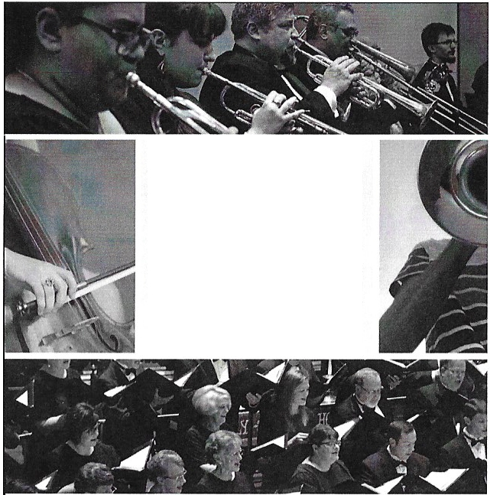
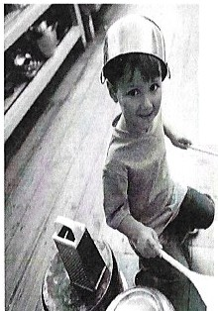

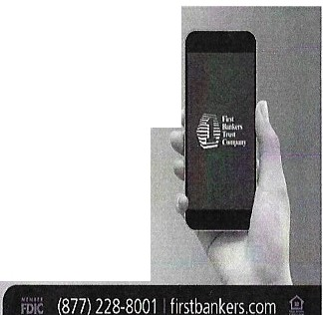
Muddy RiverOperaCompany Membership
Platinum
J.W.Gardner,Il foundation LeePaie,eLindsay
Ga rtJ L. Blickhan, C.P.A.,P.C.
Diamond
Riddell Noble in 111e111or1J oi CharlesD.Rollins William J.B.Winn and Kae Blecha
BRINGING
MUSIC
TO LIFE
Gold
Gem City Breakfast Kiwanis Club
Communit lJ Foundation Q uinClJ A rea-Sama ntha Otte Fund Dr.Carol F.Mathison
Ii0 1v!EBAN K
Iiy-Vee Broadway and Iiarrison AnnNae,y
Frank and Sara Anton North
Quincy SocietlJ of FineArts Ronald Vecchie
Silver
Dr. John and Ka.thy Bozdech in memonJ of Avril Marie Bernze n and Ma.rlJ Ann Middendod
Sha.rkelJ Tra nsportation
Iiarold B.and Ka.thlJ Oaldeq Sie,ne OaklelJ
Our 2019-20 Season features our amazing orchestra and chorus, talented young musicians, and dynamic guest artists.
Season tickets on sale now
New subscribers: two tic ke ts for the price of one.
l
Never miss a beat
m when yo bank electronicay!ll,
- . ; , ".I •
Want to join one of our ensembles?
Visit our website for audition information.
' .
QUINCY
MPHONY
<? AE ITOR
qsoa.org
217-222-2856
r
. } 1

Slide 7
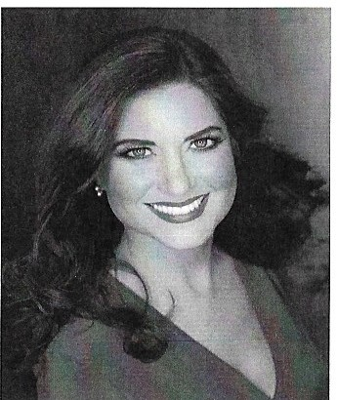
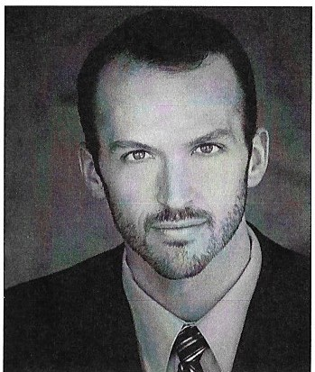
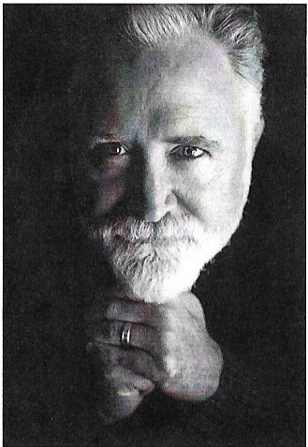
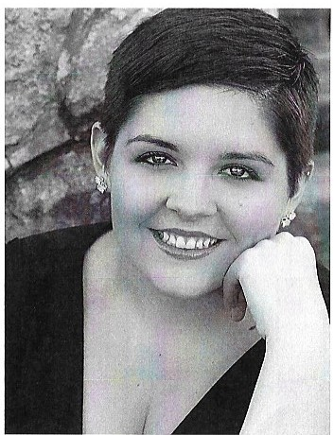
Pra ised blJ The New Yo rk Ti111es for s i n5 i n5 w it h "bell-like clarity and surpassin5 sweetness,"Penelope
Shumate has appeared at both Ca.rne5ie Iia.11and Lincoln Ce nter in New York CitlJ.She is the first placewinner in
the'2019 American Prize for Vocal
Pe rforma nce in Oratorio and thissummer
debuts with the RotJa.l Ph ilha nn onic Orchestra £or a.recordin5 at historic Abbey Road Studios in London.She ha.s a lso su115wit h opera.companies a.nd orchestras across America..
Visit w'.vwp. e nelopeslnuna.te. 0111
Pra ised for his powedul, colorfu l si115i n 5, tenorStephe11 Carroll recentllJ made his principal artist debut at Vir5inia Opera as Don O tta.vie in Dori Giov c11. Jni. Recent operatic roles include Normanno in Lucia di Lammennoorwith Vir5inia Opera.,
Dr. Bli nd in Die flede.n:naus,wi th The Santa FeOpera,Cassio in Otellowith Dayton Opera,Malcolm in Mac.beth,
First Armored Ma.n in I.beMtlf5icri llte
wit h The Gli111111er5lass Festiva l, and
S t eve in A Streetct1r Nt1111ed D esire wi t h
Ke nt u c k y Opera.Ori5inally from Scotch Plains, NJ,Stephen holds a.n artist diploma from the Collee e- Conserva.tory of Music in Cincinnati, a master's de5reehom Unive rsit-y of North Texas, and a bachelor's de5reefrom the UniverSitlJ of De lawa re
t
i
Penelope Shumate la.urie
Stephen Co.rroll
Martin
Ma rk G il5all on isdeli5hted to return to QuinctJ and to the role of Grandpa Moss, which he performed for Muddy River
Opera in1995. lie debutedwith the company in 1990 as Simeon in Th.e Nc1.tivitlj AccordintJ to St.L uJ e a nd last appeared as Gior5ioGermont in
La Trc1.vic1.tc1..
S i nce La Trc1.viata, solo debuts were ma.de
a t Carne5ie and AvertJ F ish e r li alls, with the J11d ia na po l is, Detroit,Pittsbur5h, Balti111ore, and Kansas City symphonies, and the C incin nati PopswithErich Kunzel. In add ition to Mark's perfor111i115 ca ree r, he serves as Director of Music at North United Methodist Church in Indianapolisand a studio musician recordin5 for Beckenhorst, Shaw11ee -, I Ia l Leonard, Ii ope, Lorenz and other choral publishers.
Mezzo-Soprano Lisa Blake holds de5rees from Truman Stateand Missouri Sta.te Unive rsih.1. She has been featured as a soloist for Bach's Mc1.tJ11iticat, Ii alJdn 's Lord Nelson Mass,li a nde l's Israelin E{Jypt and Messiah ,and Mozart's Requiem.This will be her fifth production with
MRO C. Someof her roles include Principessa.i n SuorA11gelict1, Mercedes in Carmen,and Lady 3 in I.beMtlf5ic flute.Lisa. has studied voicewith
PhlJlli s Robe rtson, Carol Mathieson, and Ann MarieW ilcox- Daehn.
'i
if
Mark GiJsdilon Grandpt1 Moss
LisaBlake
MaMoss

Slide 8
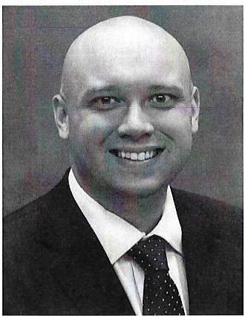
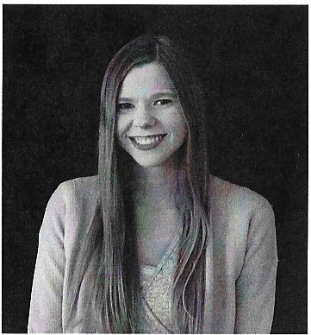
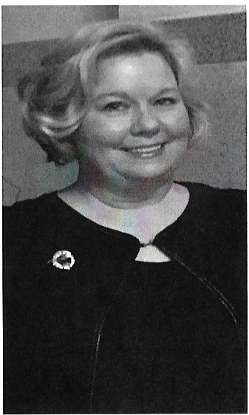
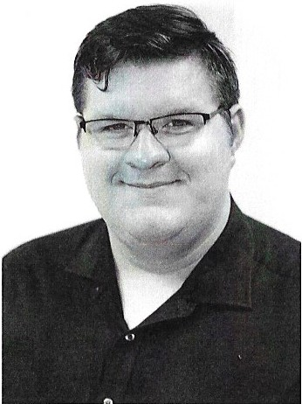
Th is marks Bass-Baritone Steven Soebbin5's fourth appearancewith MuddtJ River O pe ra. Most
Emily OozierworksatJohnWood ConununitlJ Colle5e a.s an Adult Education Tra.nsition C oordina tor. She 5raduated from Ripon Colle5e in 2014 (BA, Iiistory)a nd isa QuinClJ M tive.
She has mostll) been seen on the sta5e of Quincy Community Theatre, but isveflj excited for her opera.debut with Muddy River.She en0j lJS travelin5, sin5in5, a.ctin5,ca.ts,and spendin5 timewith friends, family, and her husband, David Scn11uels.
recentltJ,hewas Papaeeno io Jl,e fvfat;Ji c flute. Stevenistheinstructor of music and thea te r at John Wood Co1111nunittJ Colleee. A native ol Q uinctJ, Illin ois, he rece iv ed hi s doctorate a.nd masters from the UniversitJt ol Nebraska - Lincoln a.nd a
bachelo r"s in voca l performance and En5lish from the UniversittJ of Notre Dame.- J Ie has performed nume rousopera. roles includine, Seneca
(L j,1coroncizio11e di Pop pea),Mercntio(Rom eo et Juli e tt e ),The Count (L e No zze di I'i[Jaro),and N ic k Bottom (A M,·ds,,mmerNi₈J-,t Dremn). Asa.
librettistwith the composer Garrett Iiope,their work The Pc1ssio11 ol lehmme,anoperaon Joc111 of Arc,premie red in 2015a.t Lin coln, Nebraska, was performed at UniversihJ ol G eor5 ia in 2018,and is
set lor a 2020 NewYorlcCillJ debu t.
Emily Dozier BetkMoss
Steven Soehl,inlJ
lop
This is AmlJ Stollb e re's fou rth lJe a.r as directorof choirsat Q uinClJ Unive rsit tJ. Born and raised in Pa.l ml)ta., Missouri, AmlJ received her Bachelor ol Music de5 ree from Culver-Stockton Co lle5e a.nd re turned to Palm1Jra.and ta.ue ht bot h instnun ent a.land vocal music for era.des live
throu5h twelve.She obtained a Maste rof Education Administration de5reelrom Trnma.11State
UniverSil lJ. AmlJ has ta ue ht a pplied voiceat Culver-Stockton Colle5e and present!\) teac hes in her privatesh,dio in QuinctJ. She is the choir director at Christ Lutl1eran Church,QuinclJ a.nd has bee n a membe r ol the QuillClJ StJmphomJ Chorusservin,gas sopranosectionco-leade r..She has sun5a.s so lo ist with the QuinClJ S,pnphonlJ
O rchestra A ssocia tion-(1Iansel and G retel}, the Mudd1:1 Rive r O pera CompanlJ (Suor An,gelica.) and on the Sunda.lJ MusicSeries. She ha.s been a 5uest conductor and ad judica tor for choral and vocal contestsa.11over Weste rn Illinois a.nd Northwest Missouri.This pa.st Ma1J,Am1J was
invited to conduct the 900 -1:1e a.r old Stadtsineechor zu li alle (TheIi alle, GermantJ BolJSC hoir ) as thetJ
so n5 John Rutter's"The Lord BlessYou and Keep
You" olone with her QU choir.AmlJ a,1d he r
hu sba nd JeH havethreeadult dau5hters a.nd one f\rand cla uAhte r.
MatthewScheuermann iscurrentllJ stuclyi115 towards Bachelor in Arts (Music) and Ba chelor in Fine Arts (Theatre) de5rees at Culver-Stockton Colle5e. Previously, Matt hew has worked with MuddlJ River Opera Company onshowssuchas fiow Nc1.nifti. L e c1r11ed to Mc1.ke flm1, Ct1.rme11, fim1sel and Gretel,T.he M a{Jic fl u te a nd
l c1.c k t1.11d tlieBecinstalk. Matthew is excited to work once a5ain with Muddy River Opera Company, and hopefully more to come.
MattkewSclieuerma1111 Mr. Splinters
Amy Stollher15 Mrs. Splinters

Slide 9
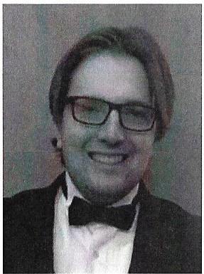
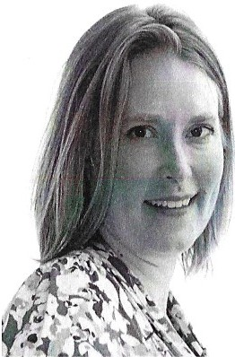
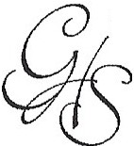
£or theirgenerosity .
Special thanks to the £ollowing supporters
David Czechut joined children' s ch o ir when he waseiaht and hasn't
looked back since.lie joined his first cast asWh itnelJ in "LifeW ith f ather" for Hannibal La.Gm.nee
Unive rsit-y and has partaken in numerous productionssince. lie worked with Muddy River Opera asThe WoH for ''Little Red Ridina Iiood" and the Witchfor
"Iiansel and Gretel" and joined "The MaaicFlute" as an armed
man.li e studied percussion performance at QuinclJ UniversitlJ with a minor in vocal performance and hopes to earn a eraduate
dearee in music composition.
Lee Paige Lindsa11
Terrell and Vicki Dempse11 AlanandCarol Nichols Gar11 Blickhan
Kevin and Pe lJ Ballard
Melissa Dubuque -Culver Stockton Alumni Association
Christ Lutheran Chuch QuinclJ UniversitlJ
John Wood Communitl] College
QuinclJ S11mphon1J Orchestra Association
DavidCzechut
Mr.Jen.ks
Our Experience, Your Future.
Planning for a secure future begins with
GRAY HUNTER STENN LLP
CERTIFIED PUBLIC ACCOUNTANTS
500 Maine Street • Quincy, Illinois 62301 217-222·0304 • FAX: 217-222-1691
ray-lmnter-stenn.com
OVER 100 YEARS OF SERVICE TO OUR CLIENTS
G retche n W olfmeye r is a mezzo-soprano from Quincy,IL. This is her fi rst appearance with MuddlJ River Opera Company. Gretchen isan activevolunteer at QuinClJ CommunitlJ The atre.
She has previously performed such roles as Mrs. Love tt in Sweeneg Toddand Carrie Pipperid₈e in Carousel.
Gretchen is a cantor and soloist at Our Redeemer Lutheran
Church.She isa member of the
Square Pea Group-Troupe, a Quincy actina troupe fou nd pe d onn ina Sha k esp ea re around town.
Gretchen Wollmeyer
Mrs.Jenks

Slide 10

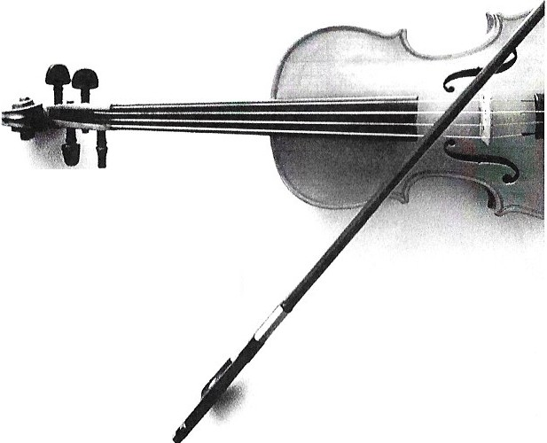
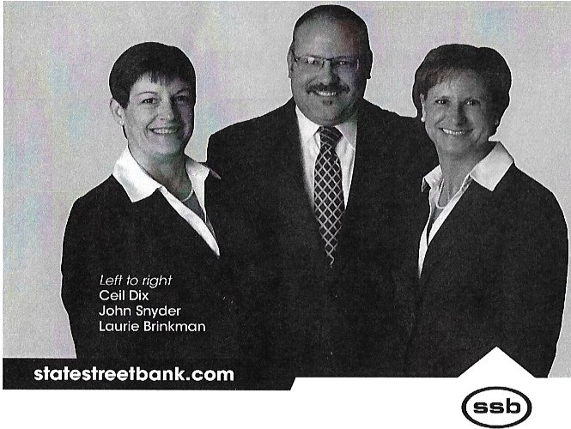
",Music,muditake;umk cw tlie,
i!s about" people{
fii<JWefr teie, iM
- cw teie,
ene,t6ftich, nte\€1tfum,ruug,etftev,
00· human, -"
not about mon1e y.
Herbert Spencer
Talk to our exper'.ienced and t11u sted- staff' today abou, t e state planning and more.
James Citro
Vice President/Investments Branch Manager
Eric Conover
Senior VicePresident/Investments
Greg Feldberg, AAMS®
Associate VicePresidentI/nvestments
David Oakley, AAMS®
Associate VicePresident/Investments
Robert Zahn
Vice President/Investments
Richard Lavery
Financial Advisor
(211) 22s-oo s3 I (866) 498-6781
3825 Maine Street Quincy, Illinois 62305
STIFEL
Sli fel. Nicolaus& Company, lncorporale<lI Mc1111Je 1SIPC& NYSEI www.slifel.com
4820 Broadway
217.277.0153
State Street Bank

Slide 11
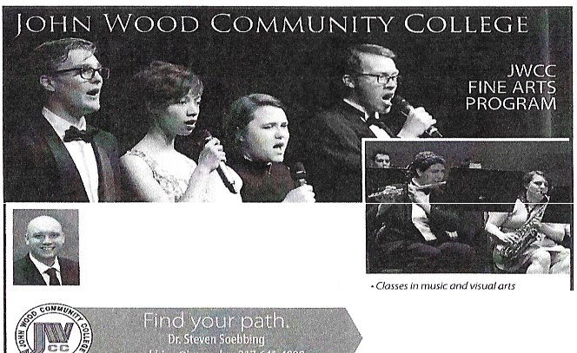


Muddy RiverOpera Company Membership Bronze
John and Rhonda Basine,er Ned and Reaue,h Broemmel Rochelle Busbey
lion.Robert W. and Fran Cook
John and lielen Cornell Merle Crossland
William and Laurie DeMont
Terrell and Vicki DempSetJ Barbara G.Gerdes William and Donna liaire
Jerry and Vire,inia liolze,rafe Bruce and Lori Kruse
Ruth Mays lion.William0 .Jr.and Sharon Mays
Geore,e and MarlJ Nell Me1:1er
Michelmann Foundation David and Ma.rt] O a kl e tJ
Sch miedeska mp,Robertson, Neu and Mitchell, LLP StateSheet Bank
Stifel
Phillip and Jeanne Soebbi115
Alan andMarlJ Ellen Stiee,emeier -in 111e111or1:1 of Dr.and Mrs.G uenth er Gehrich
Jo1:1ce W inn
Muddy River Opera Company Membership
Ruby
Karen Anderson
Dr.and Mrs.Kai Attai Leonard and Martha Biallas Jolene G. Brenner
Ned and Rea u5h Broemmel Jern.J and Suzanne Carnivale
Dr.GanJ and Geraldine Carter Ja.mes and KathlJ Citro
David Costi5an
First Banker's Trust CompanlJ Dozier Insurance Ae enClJ James and Dienna Drew Richa rd and Bar ba ra Fry Ruthliultz
James and Lori Korb Roeer D.Leac h Nona G.Lo n(>
A nne M.MatJS
M a rlJ L o u McGin,.,is Shi rle y MurphlJ Annette Newquist Janet I-I.Ni c h olas
V e rtJRev. Lewis and Mar5a rel POlJn e Dr. anclMrs.Louis Q uinl c ro
Re e d footandAnkl e Dr.PhlJllisL.Robertson Lewis and Sharon R11!fcorn John and LaniSchneide r Paul and Mary Shelo r Mary K.Wal lc,·s
D o z i e
lnsu_ance_Agen y,Jne.
JWCC M u sic and Theatre courses in struct ed by Dr. Steven Soebbing Doctorof Muslcul Arts,
Universityof Nebraska-Lincoln
Mas.tcr of Music, Univer sity of Nebraskn•Lln c.oll'1
B.A.Vocal Performance, University of NotreDame
Better RATES • CovERAGE • SERVICE
Concert choir, vocol Jfw w ememble,
}av.boridand!l'ie,m e perfo1mon ces
Associare(legreesin music edvccHion
ar1cl r>erforrr,ance
Scho /orl fii ()Sfor mo/orsond r,ou-mcrlo rs
820 STATE STREET, SUITE 12 • QUINCY (217) 224 3121
www.dn11er111!>urmt ,,-r,i.
•

Slide 12
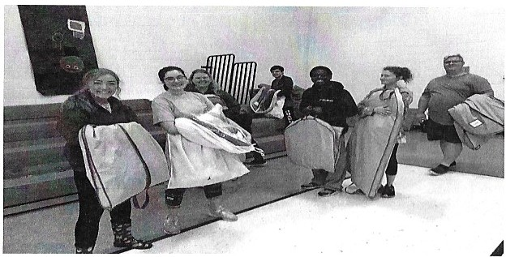


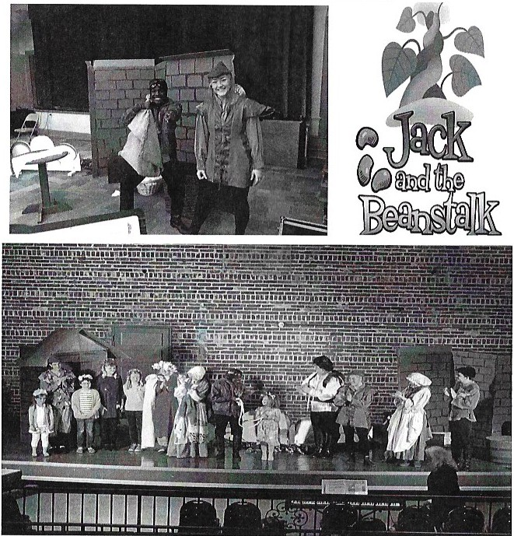



lfoo@
3700 Broadway
1400 Harrison
In March and April 2019 studenh from Culver-Stockton Colle5e,John Wood CommunitlJ Colle5e and QuiitCLJ Unive rsity perfomed the children's opera
Illinoisa nd Lewis and Marion Counti es in Missouri thanks lo5e11erous 5.rn,n ts . Jackand the Beanstalkforareaschool children in Adams and Pike Counties in
: ; 11. .
;;J
r\ . N·h p
y n1na 18 t arl-y
.. ,/
!//,,f o r Cast and Crew 'Ca te red by Hy Vee
' "B roadway and Harrison
L n
. ,b,i 6!( ·!"
.. en· .er
-. ·
, t I.
t\ ' I .a
/ ,11r '
1
. .
MUddy . .
u 1 a/
Rlverltf · ,
0P,Cf 18^{J} .^{'I}•·^{I}
l""'-' t
0 1
om, pany
r

Slide 13


H8 MEBANK
strength and service continues
►►CHECKING& SAVINGS ACCOUNTS
►► CERTIFICATES OF DEPOSIT
►► CHRISTMAS CLUB
►►HEALTH SAVINGS ACCOUNTS
►► IRA - ROTH & TRADITIONAL
►►LOANS
►►ONLINEBANKNI G
►► MOBILE APP.
►►PERSON TO PERSON FUNDS TRANSFER
►► BUSl
U:1
eou
k

